Slide 1

7th Semester
Project Presentation
on
SMART NETWORK-FOR STUDENTS ESSENTIALS
Presented by
SATYAM KUMAR SINHA(22UG010149)
RAMJEE UPADHYAY(22UG010308)
SATYABAN JENA(22UG010121)
Under the guidance of
DR.K.SIVA KRISHNA
Professor, Department of CSE, GIET University
Gandhi Institute of Engineering and Technology University
November 2023

Slide 2
MAJor PROJECT i PRESENTATION ON SMART NETWORK-FOR STUDENTS ESSENTIALS
SCHOOL OF ENGINEERING AND TECHNOLOGY
DEPARTMENT OF COMPUTER SCIENCE AND ENGINEERING
Presented By:
SATYAM KUMAR SINHA(22UG010149)
RAMJEE UPADHYAY(22UG010308)
SATYABAN JENA(22UG010121)
Under the Guidance of DR. K SHIVA KRISHNA

Slide 3
Understanding the Need
Problem & Our Objectives
The Student Struggle
Our Solution: A Unified Approach
University life brings unique challenges beyond academics. Students often find themselves overwhelmed by the scattered resources needed for daily living and future planning:
Our project aims to solve this by creating a centralized platform with clear objectives:
Unified Access: Provide a single portal for housing, food, academics, and placements.
Finding suitable housing.
Simplified Tasks: Streamline daily routines through integrated services.
Accessing convenient food options.
Navigating online courses and academic materials.
Academic Growth: Integrate online learning and comprehensive academic resources.
Preparing for placements and career opportunities.
Career Readiness: Enhance placement preparation with curated tools and content.
This fragmentation leads to wasted time, increased stress, and reduced efficiency in managing essential aspects of student life.

Slide 4

Laying the Foundation
Research & Requirements
Literature Survey
Requirement Analysis
Our research involved reviewing over 10 academic papers on existing web platforms for student services, e-learning systems, and online resource integration.
Key Finding: While numerous solutions exist for individual domains (e.g., housing portals, food delivery apps, academic resource sites), no single, centralized platform comprehensively addresses all core student needs.
This identified gap reinforces the novelty and necessity of our "Smart Network for Student Essentials."

Slide 5
To ensure our platform meets student demands, we conducted a thorough requirement analysis, outlining critical features:
Secure User Login & Authentication
Dedicated Service Modules (Housing, Food, Academics, Placements)
Intuitive User Interface & Dashboard
Robust Admin Panel for content management
Secure Payment Gateway Integration

Slide 6




Our Blueprint
Methodology & Workflow
User Registration & Authentication
Service Requests
Secure JWT-based login for personalized access.
Modules for Housing, Food, Courses, and Placement Tools.
Data Handling
Personalized Dashboard
Backend database with external API integrations.
Centralized access to all modules and relevant information.
Key Technologies Driving Our Vision
Frontend
Backend
Database
APIs
React.js: For a dynamic and responsive user interface.
Node.js/Express: (or Django) For robust server-side logic.
MongoDB: Flexible NoSQL database for efficient data storage.
Google Maps, Payment Gateways (Razorpay/Stripe), Online Course APIs: For integrated functionalities.

Slide 7
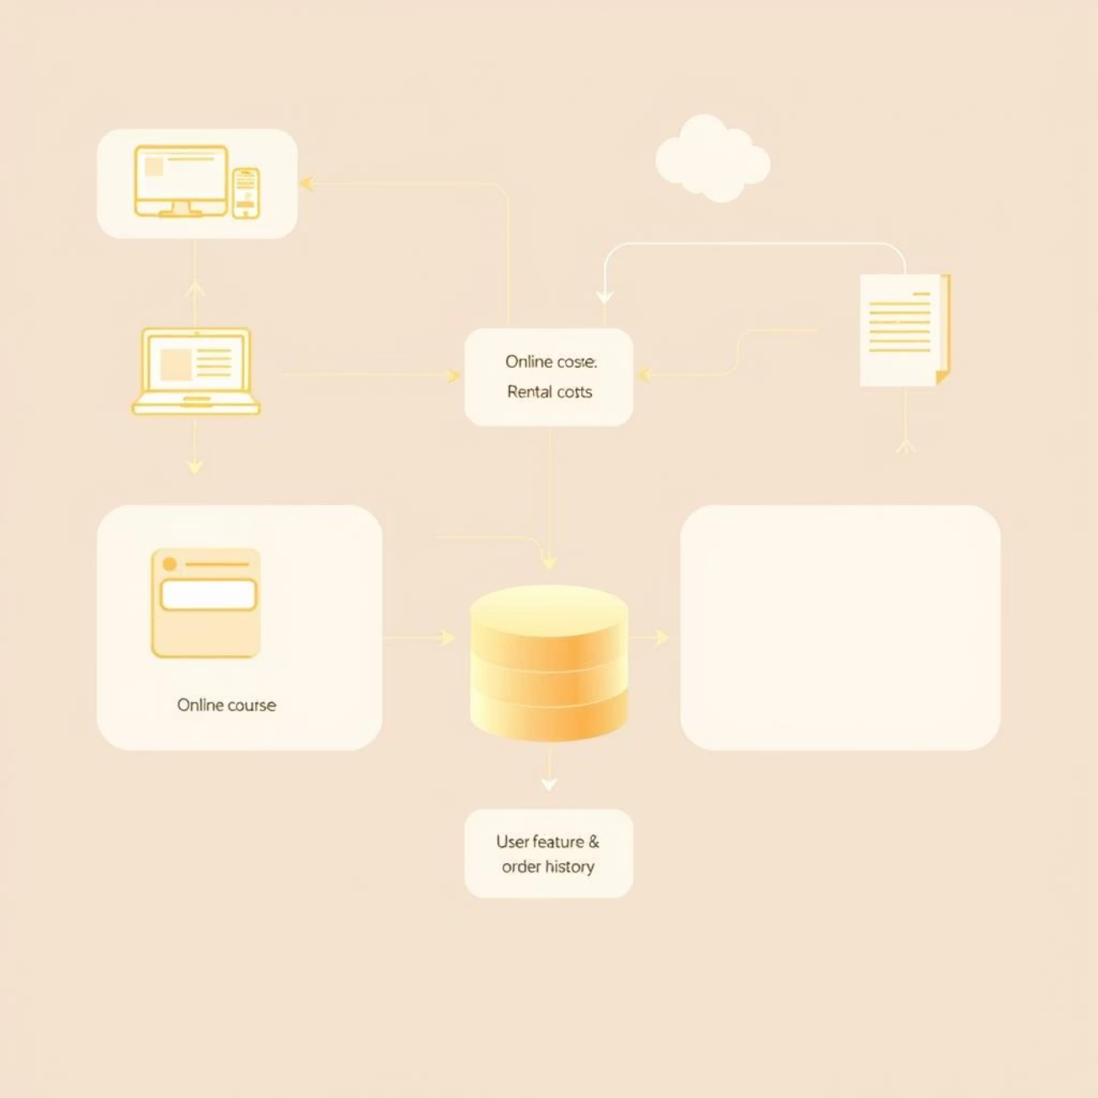
Data at Our Core
Dataset & Information Flow
The effectiveness of our platform hinges on comprehensive and relevant data. We are integrating various datasets and information sources:
Online Courses: Leveraging APIs from e-learning platforms and open educational repositories.
Academic Resources: Facilitating user uploads (notes, PDFs, quizzes) and curated institutional content.
Placement Material: Curated content for aptitude tests, resume building, interview preparation, and job listings.
Housing & Food: Integrating real-time rental listings, food vendor data, and menu information.
Key parameters include course information, rental costs, user preferences, geolocation data for services, and historical order information.

Slide 8

Where We Stand
Progress to Date
01
02
03
Literature Survey Completed
Requirement Analysis Finalized
Preliminary Design Developed
Comprehensive research into existing solutions and identified critical gaps.
Initial module structure and dashboard layout established.
Detailed breakdown of features and functionalities based on student needs.
Overall Work Completion: Approximately 40%
We are on track, having established a solid theoretical and conceptual foundation for the project.

Slide 9
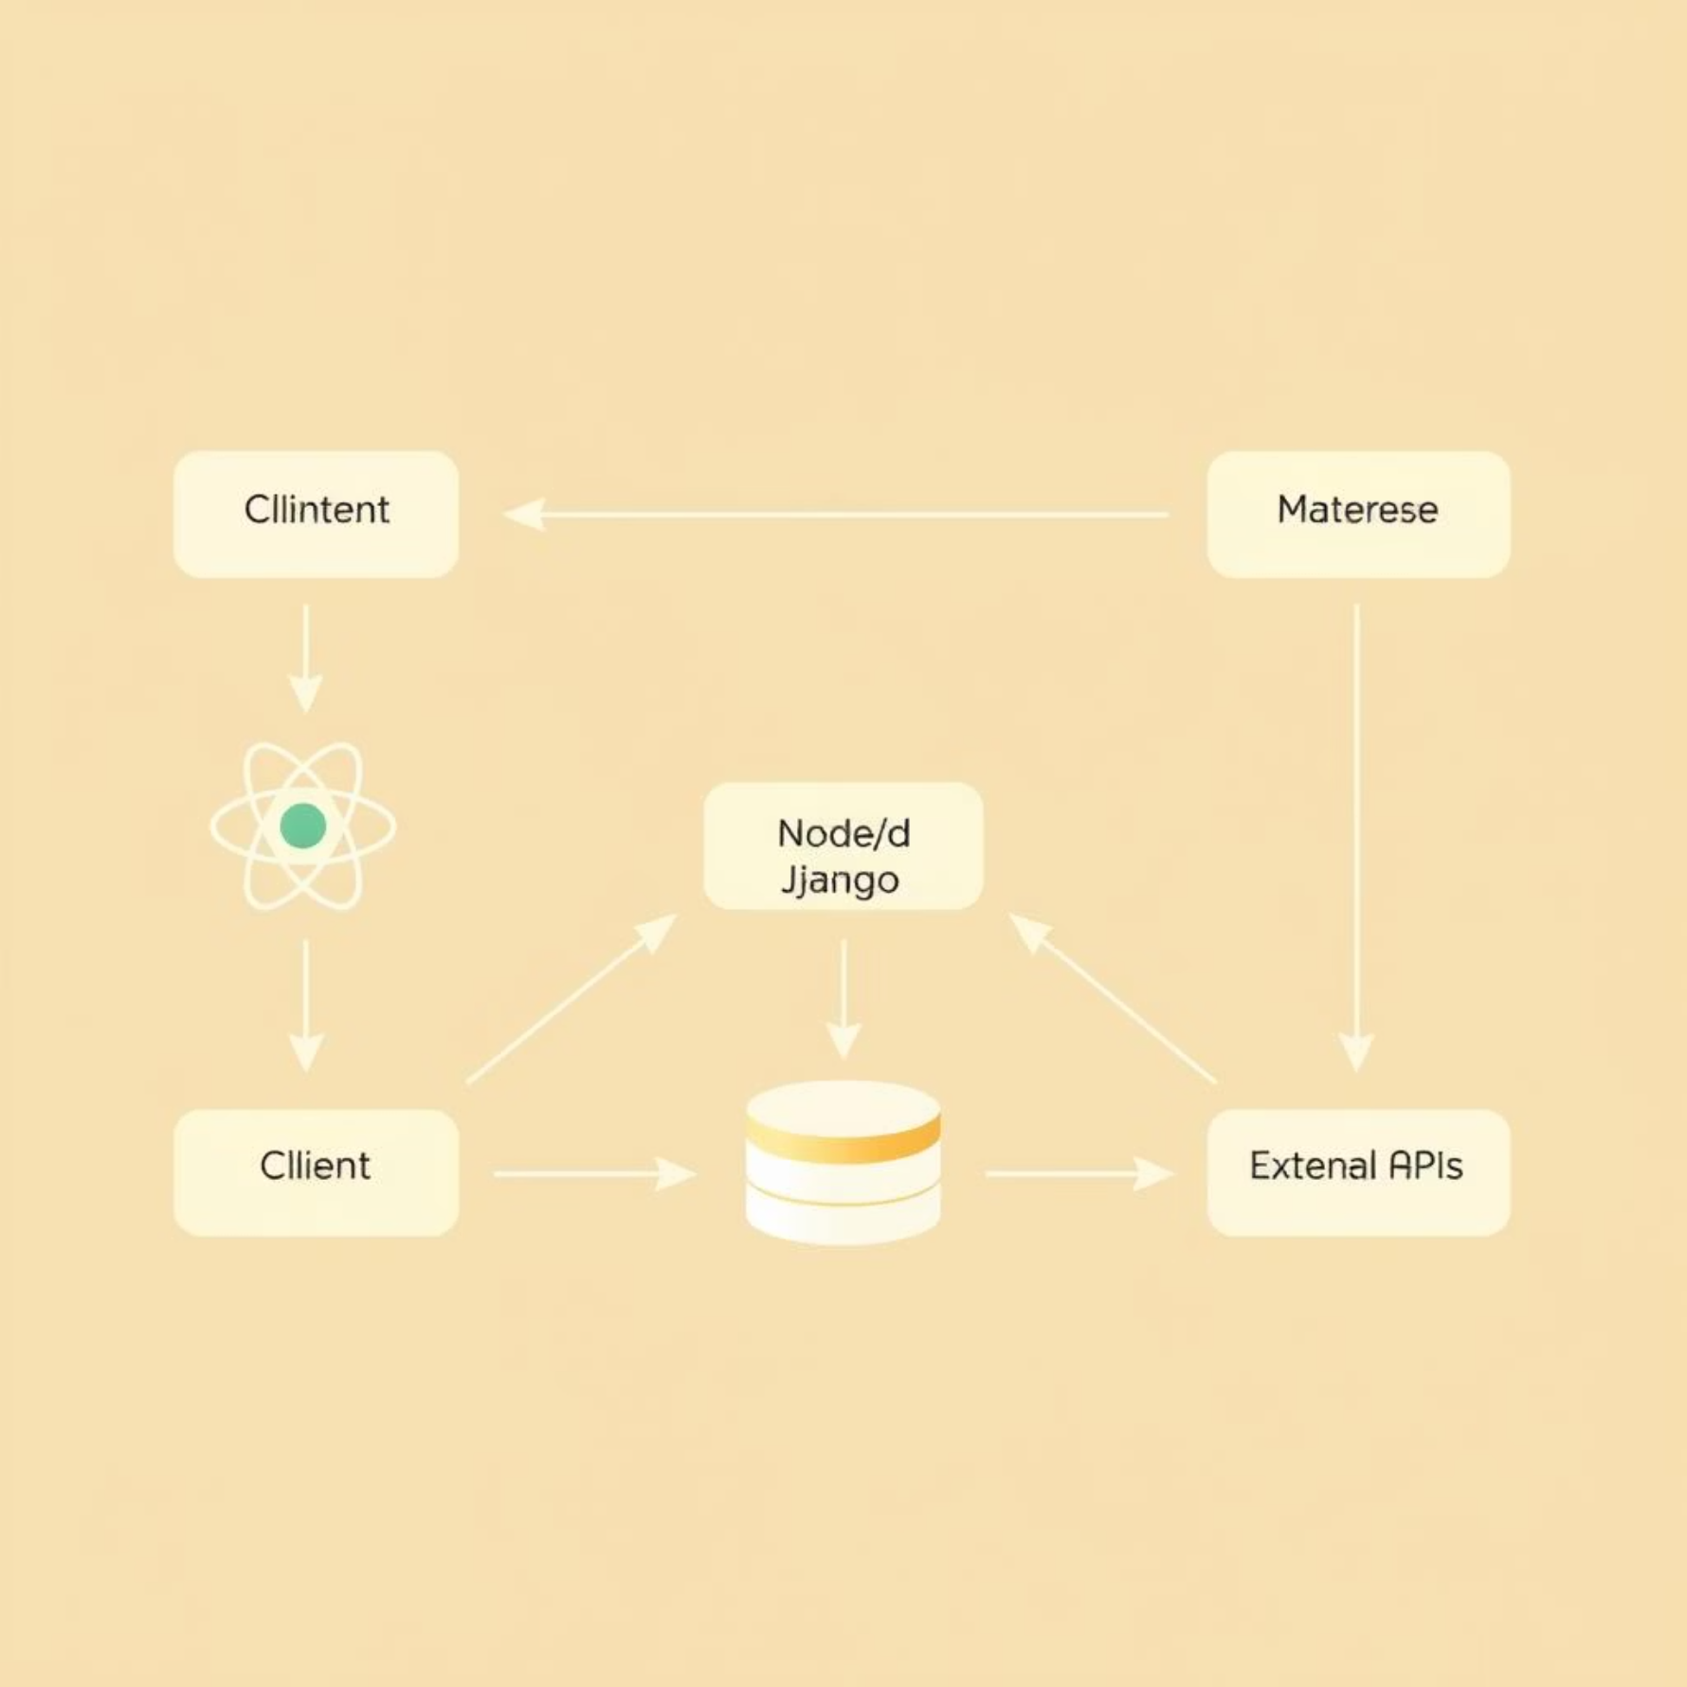
Architecting the Future
Preliminary Design & Architecture
Conceptual Design
System Architecture
At the heart of our design is a unified dashboard that serves as the central hub for students. From this single interface, users can seamlessly navigate between:
Housing Listings
Placement Tools
Academic Resources
Food Ordering

Slide 10

Our architecture is designed for scalability and efficiency, featuring a clear separation of concerns to ensure robust performance and maintainability.
Initial Screen Mockups Include:
1
2
Login Page
Main Dashboard
Secure authentication point.
Personalized overview and quick access.
3
4
Rentals & Housing
Food Orders
Browse listings and connect with landlords.
Menu browsing and order placement.
5
6
Courses & Academics
Placement Tools
Access learning materials and schedules.
Resume builders, practice tests, job boards.

Slide 11

Navigating the Path
Challenges & Solutions
Anticipated Hurdles
Data Availability: Limited structured datasets for specialized content like courses and placement materials.
API Integration: Seamlessly connecting diverse third-party APIs for payments, geolocation, and content delivery.
Performance: Ensuring smooth and responsive performance across all integrated modules, especially under heavy load.

Slide 12
Our Plan to Overcome
Modular Architecture
Designing modules independently allows for easier integration and debugging.
Sample Datasets
Utilizing representative sample data for early testing and development.
Scalable Backend
Building a robust backend infrastructure capable of handling future growth.

Slide 13

The Road Ahead
Next Steps (Target: September 15)
1
Prototype Development
2
Authentication & Database
3
API Integration
Build functional prototypes for two core modules: Housing and Food.
Begin integrating essential APIs like payment gateways and geolocation services.
Implement secure user authentication and finalize the core database structure.
Key Deliverables:
A working demo of the core dashboard with integrated modules, along with updated project documentation.

Slide 14

Our Commitment
Conclusion & Contribution
Project Status
Novelty & Impact
We have successfully completed the critical initial phases of our project including:
Comprehensive Literature Review
Detailed Requirement Analysis
Preliminary System Design & Architecture
Currently, approximately 40% of the project work has been completed, laying a strong foundation for the development phase.

Slide 15
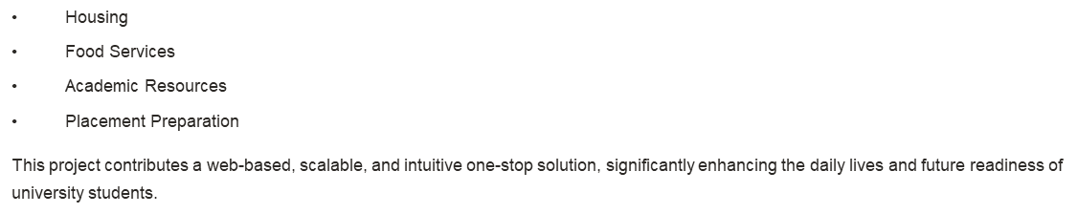
Our "Smart Network for Student Essentials" stands out as a unique solution by being the first student-centric platform that seamlessly merges essential services:

